Slide 1
ZOMATO
Order & Restaurant Analysis Using Power BI
Domain - Food & Beverage, Business Analytics
Submit By – Harshada Kardile
10 Power BI Tasks · SQL Data Pipeline · Business Insights
Domain: Food & Beverage · Business Analytics | Tools: MySQL · Power BI · DAX

Slide 2
Agenda
01
Problem Statement & Approach (SQL → Power BI)
02
Power BI Task 1–10 — Visual Walkthrough
03
Overall Analysis & Business Recommendations
04
Conclusion

Slide 3
Problem
Statement
Business Objectives
Identify top-performing restaurants by rating & order volume
Zomato generates large volumes of restaurant and order data daily. This project analyzes and visualizes that data to uncover trends in customer preferences, restaurant performance, pricing impact, and location-based insights.
Analyze how pricing impacts customer orders
Understand customer preferences across cities & areas
Evaluate delivery time efficiency
Surface demand trends for future growth
Approach
Final Data Model
MySQL: table design + FK relationship
Zomato_Orders
Zomato_Restaurants
SQL: profiling, cleaning, TRIM standardization
restaurant_id (FK) · order_id (PK)
restaurant_id (PK)
SQL: exploration, aggregation, joins/view
Power BI: Many-to-One data model
Many-to-One · Single cross-filter
Power BI: DAX measures + 4-page dashboard covering 10 tasks

Slide 4
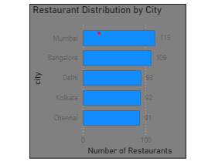
TASK 1
Number of Restaurants per City
Objective: Analyze restaurant distribution across cities to identify high- and low-density markets.
Insight: Mumbai (115) and Bangalore (109) lead in restaurant count; Chennai has the fewest (91) — a fairly even spread overall.

Slide 5
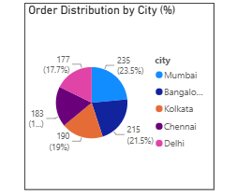
TASK 2
Percentage of Orders from Different Cities
Objective: Understand which cities contribute most to total orders and how demand varies by region.
Insight: Bangalore drives the largest order share (22.56%), closely followed by Mumbai (22%) — demand roughly tracks restaurant density but Bangalore slightly over-indexes.

Slide 6
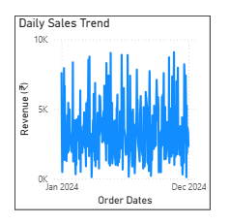
TASK 3
Order Amount Trends Over Time
Objective: Visualize how order amounts fluctuate over time to spot peak and slow periods.
Insight: Daily revenue fluctuates between ₹20K–₹80K with no single sustained peak season, suggesting demand is fairly steady with normal day-to-day variance.

Slide 7
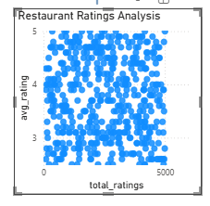
TASK 4
Correlation of Factors Affecting Average Rating
Objective: Identify relationships between price, delivery time, total ratings, and average rating.
Insight: Across all three scatter views (order value, delivery time, total ratings vs. rating), no strong linear correlation emerges — rating appears driven by factors beyond price or wait time alone.

Slide 8
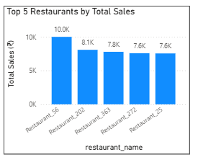
TASK 5
Top 5 Restaurants by Total Sales
Objective: Identify the highest-earning restaurants based on total revenue.
Insight: Restaurant_116 leads with ₹51K in sales; the top 5 are tightly clustered (₹48K–₹51K), showing no single dominant outlier restaurant.

Slide 9
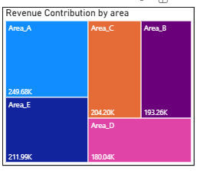
TASK 6
Revenue by Area Using a Tree Map
Objective: Visualize revenue contribution from different areas to spot high/low-performing localities.
Insight: Area_A leads with ₹3.39M in revenue, while Area_E trails at ₹2.91M — a relatively balanced spread across all 5 areas, with no single area dominating.

Slide 10
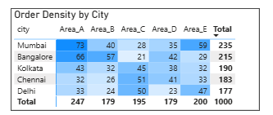
TASK 7
Order Density by City Using a Heat Map
Objective: Analyze which cities have the highest concentration of orders using conditional-formatted density coloring.
Insight: Mumbai (235) and Bangalore (215) lead order density, with Area_A the hottest zone in both cities (73 and 66 respectively); Delhi (177) trails as the lowest-density city.

Slide 11
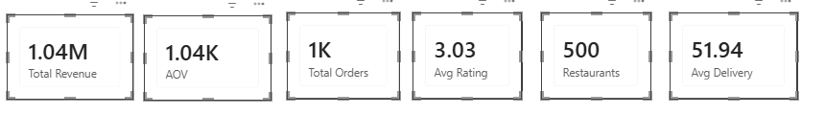
TASK 8
KPI Cards — Total Revenue & Average Order Value
Objective: Display key business performance metrics as easy-to-read KPI cards.
Insight. Restaurant_56 leads with ₹10.0K in sales, noticeably ahead of the rest (₹7.6K–8.1K) — the only visible outlier in an otherwise tightly clustered top 5.

Slide 12
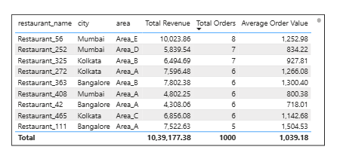
TASK 9
Restaurant-Wise Sales Summary in a Table
Objective: Summarize restaurant-wise sales performance with sorting and filtering by city, area, or price range.
Insight: The sortable, filterable summary table (Restaurant Name, city, area, Total Sales, Order Totals, Avg Order Value) lets stakeholders drill into any city/area/price-range slice on demand.

Slide 13
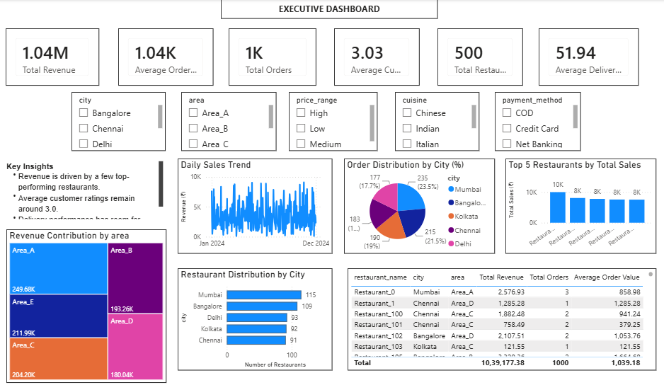
TASK 10
Power BI Dashboard — Combining All Visuals
Objective: Create a fully interactive executive dashboard combining all visuals with synchronized slicers.
Insight: One unified view — KPI cards, revenue by area, sales trend, order distribution, top restaurants, and the summary table — with city/area/price-range/cuisine/payment slicers for full drill-down.

Slide 14
Overall Analysis & Recommendations
WHAT WE LEARNED
RECOMMENDATION
Supply is concentrated (Mumbai 115, Bangalore 109 restaurants) but demand is more evenly spread — Chennai/Kolkata/Delhi generate meaningful orders despite fewer restaurants (Tasks 1, 2, 7).
Expand restaurant onboarding and delivery capacity in Chennai, Kolkata, and Delhi to close the supply–demand gap.
Revenue is broad-based, not outlier-driven — top 5 restaurants cluster tightly (₹48K–51K) and all 5 areas contribute similarly (₹2.91M–3.39M) (Tasks 5, 6).
Study operating practices at top restaurants and Area_A/Area_B; share playbooks with lower-performing areas.
Rating isn't explained by price or delivery speed alone — none of the correlation scatter plots show a strong pattern (Task 4).
Prioritize food-quality and order-accuracy audits over price-based promotions to lift the 3.00 average rating.
Delivery time (52.39 min avg) is on the higher side and a plausible factor behind rating variation (Task 8).
Run a root-cause logistics review city-by-city, starting where order density (Task 7) is highest and delivery is slowest.
The dashboard is fully interactive across city, area, price range, cuisine, and payment method (Task 10).
Track the dashboard on a recurring cadence (weekly/monthly) to confirm rating and delivery time trend in the right direction.

Slide 15
Conclusion
All 10 required Power BI tasks were completed on a clean, SQL-transformed, relationally-modeled dataset — producing an interactive dashboard that identifies high-performing restaurants, city/area demand patterns, and concrete levers (restaurant supply, delivery time, targeted promotions) for business growth.
Thank You

